Slide 1
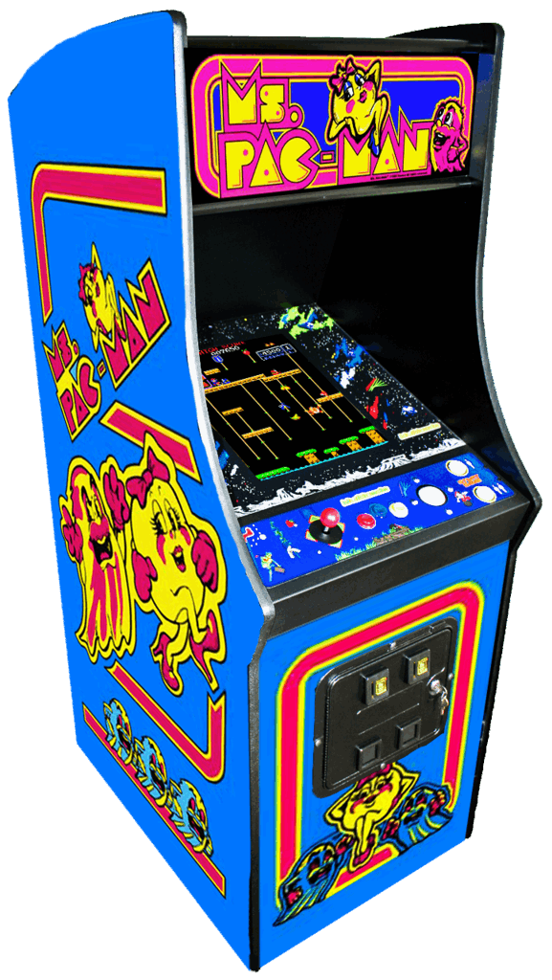
> Ansuman Mahapatra(23CSE522)
> Biswajeet Patra(23CSE531)
> Tapan Kumar Sahoo(23CSE549)
Dt – 17/08/2024

Slide 2
INTRODUCTION
Overview of Pac-Man:
Pac-Man is one of the most iconic and enduring video games, originally released in 1980.
Known for its simple yet addictive gameplay and its impact on gaming culture.
About the Project:
I developed a modern version of Pac-Man as a personal project to explore game development.
The goal was to create a game that captures the essence of the original while incorporating modern design and features.
Purpose of the Presentation:
To showcase the development process of my Pac-Man game.
Highlight key features, design decisions, and challenges faced during the project.
Share insights and learnings from creating a game inspired by a classic.

Slide 3

HYSTORY OF PAC-MAN
Pac-Man is a game that was firstly developed by a Japanese video game company Namco .
The game was designed by Toru Iwatani, a young game designer who wanted to create a game that would appeal to a broader audience, including women, who were not typically seen as a target demographic for video games at the time.

Slide 4

DEVELOPMENT
The development of Pac-Man began in 1979 and took about a year. The game was originally titled "Puck Man" in Japan, a reference to the puck-like shape of the main character. However, when the game was prepared for release in the United States, the name was changed to Pac-Man .

Slide 5

CONCEPT OF PAC-MAN
Iwatani wanted to move away from the violent themes prevalent in video games of the time, focusing instead on a game with a non-violent and universal appeal. The idea for Pac-Man came from the Japanese word "paku," which describes the sound of eating. The design of the character was inspired by the shape of a pizza with a missing slice.

Slide 6
CONTENT :
Why We Chose Pac-Man:
We've always loved playing Pac-Man for its strategic and challenging gameplay.
The thrill of outsmarting the ghosts made us want to create our own version.
Power Pellet Inspiration:
The Power Pellet mechanic, where Pac-Man can turn the tables on the ghosts, particularly inspired me and my friends.
In our version, I’ve enhanced the Power Pellet’s impact to make it even more exciting and central to the game.

Slide 7
GAME DESIGN :
Pac-Man remains the central character, with a modernized look.
The ghosts include the classic four (Blinky, Pinky, Inky, Clyde) plus two new ghost characters with distinct behaviors.
Maintained the classic elements while introducing new paths and challenges.
Focused on vibrant colors and smooth animations to enhance the gameplay experience.

Slide 8
DEVELOPMENT PROCESS :
Tools and Technologies:
We used HTML , CSS , Java script to make the basis of the game.
We also use some images of Pac-Man character and ghosts character.
Milestones:
Completed initial game prototype.
Integrated key features like Power Pellets and ghost AI and I uses the below six ghost AI .

Slide 9
GAME MECHANISM :
Scoring System:
Points awarded for eating dots, ghosts, and bonus items.
New scoring mechanics include extra points for consecutive ghost captures.
Core Gameplay:
Players navigate Pac-Man through the eating dots while avoiding ghosts.
Power Pellets enable Pac-Man to eat ghosts for a limited time.

Slide 10
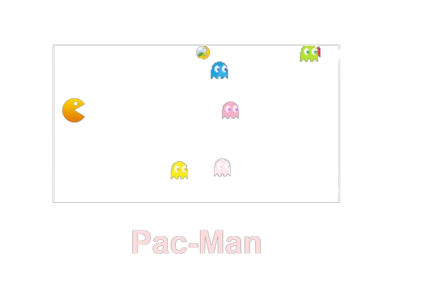
USER INTERFACE :
Layout:
Simple and intuitive interface, focusing on ease of use.
Navigation:
Responsive controls for smooth player movement.
Menu system allowing players to start, pause, or adjust settings easily.

Slide 11
FUTURE ENHANCEMENT :
Planned Updates:
Add new levels and mazes with unique challenges.
Introduce additional power-ups and special abilities.
Future Features:
Potential for multiplayer modes or leaderboards.
Explore more advanced AI for a dynamic gameplay experience.

Slide 12

PACMAN

Slide 13
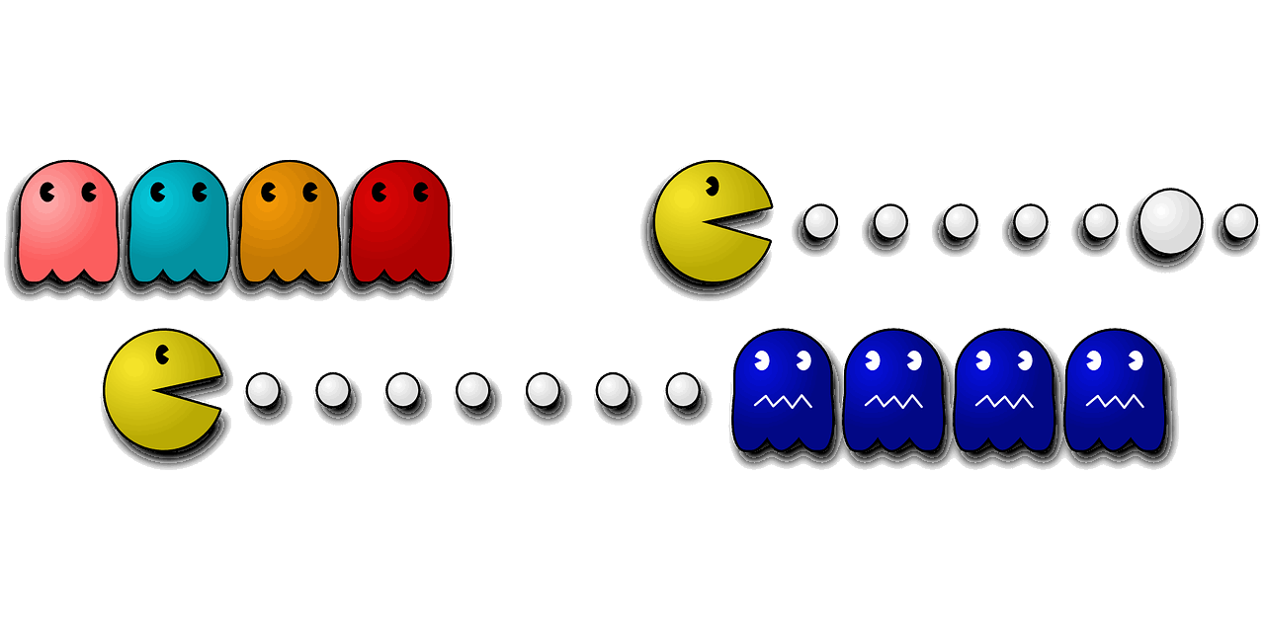
Break Out
Here is where your presentation begins

Slide 14
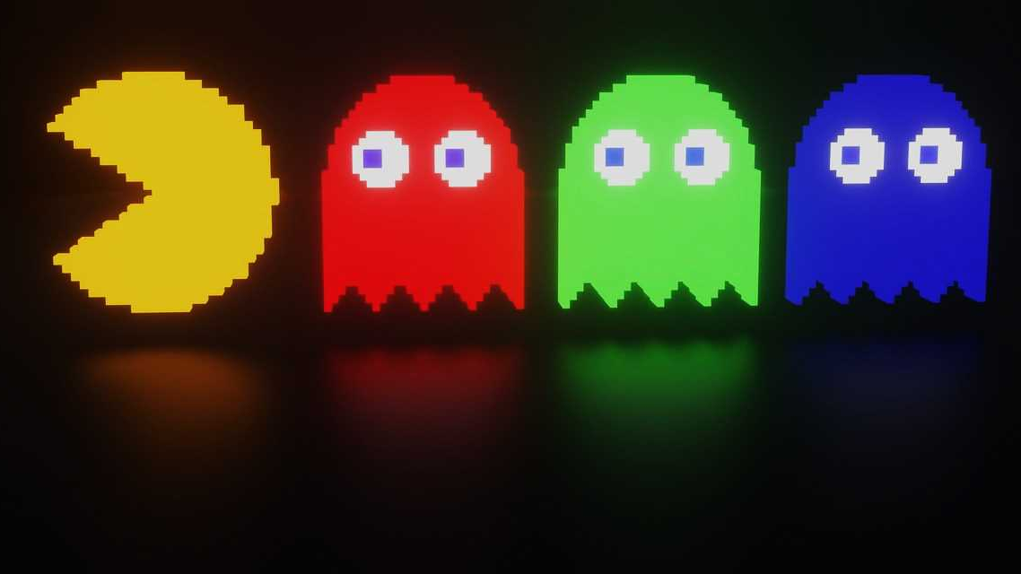

Whoa! That’s a big number, aren’t you proud?

Slide 15
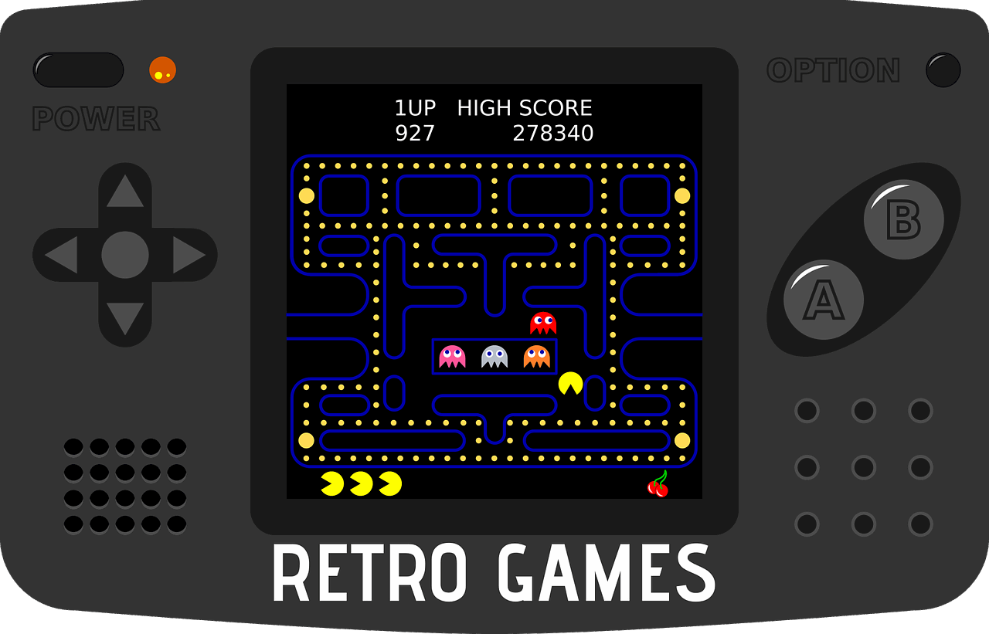

Slide 16

Hello!
I am Ansuman Mahapatra.
I am here because I love to give presentations.

Slide 17
Hello!
I am Biswajeet Patra.
I am here because I love to give presentations.

Slide 18
Hello!
I am Tapan Kumar Sahoo.
I am here because I love to give presentations.

Slide 19
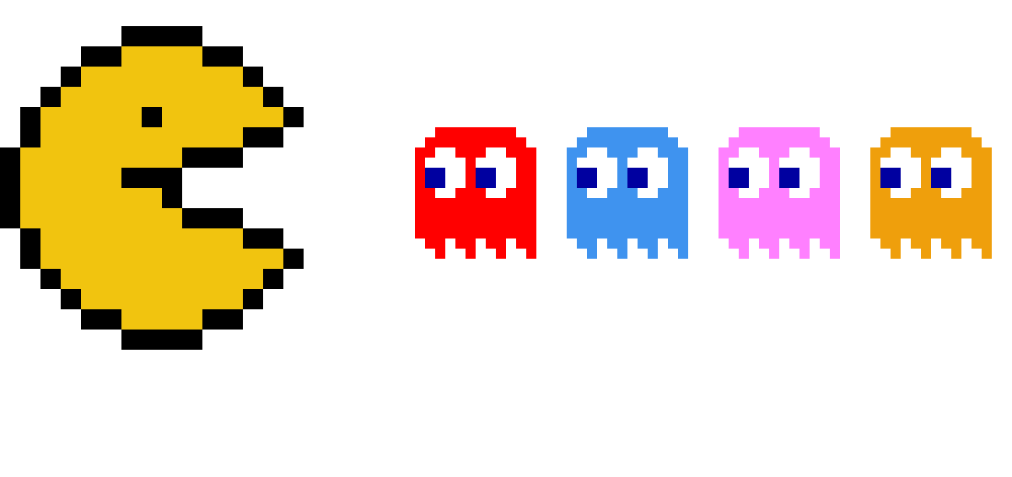

Slide 20
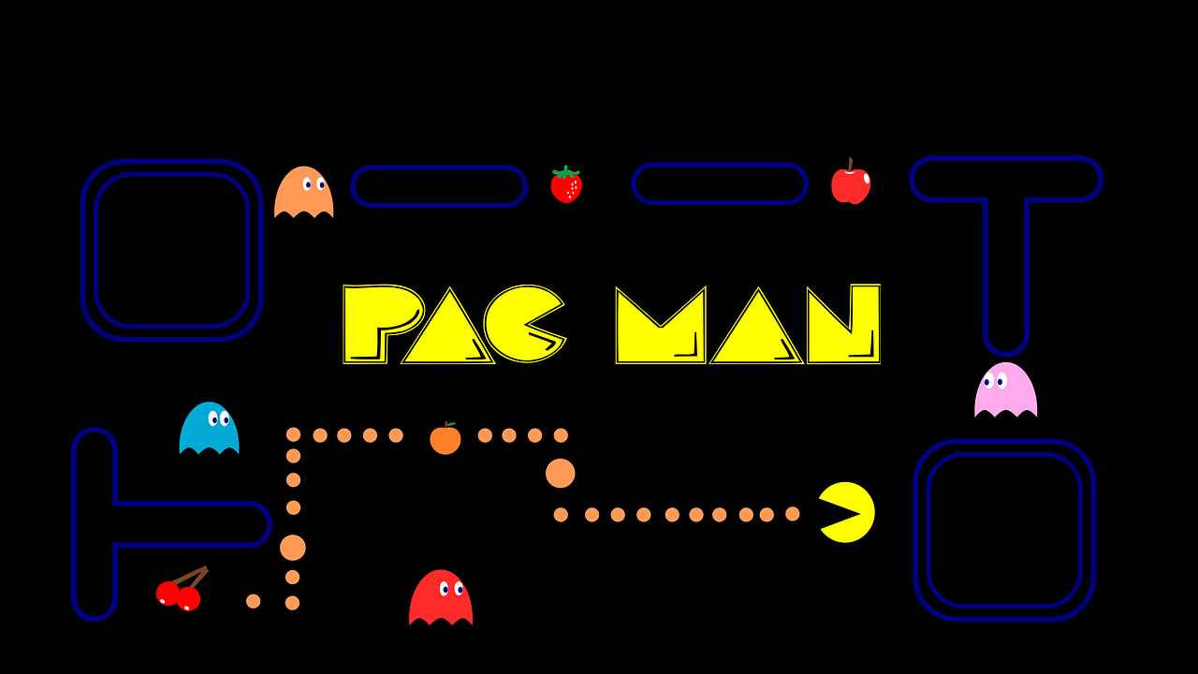
Let’s review some concepts

Slide 21
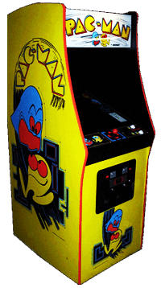

Big Game

Slide 22
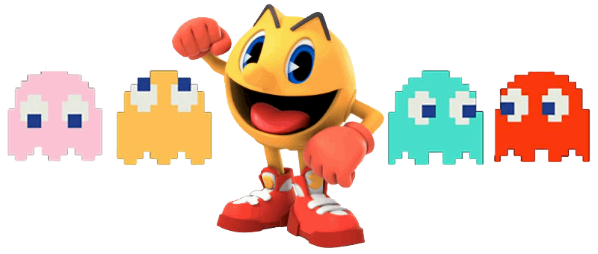
89,526,124
Whoa! That’s a big number, aren’t you proud?

Slide 23


winner

Slide 24
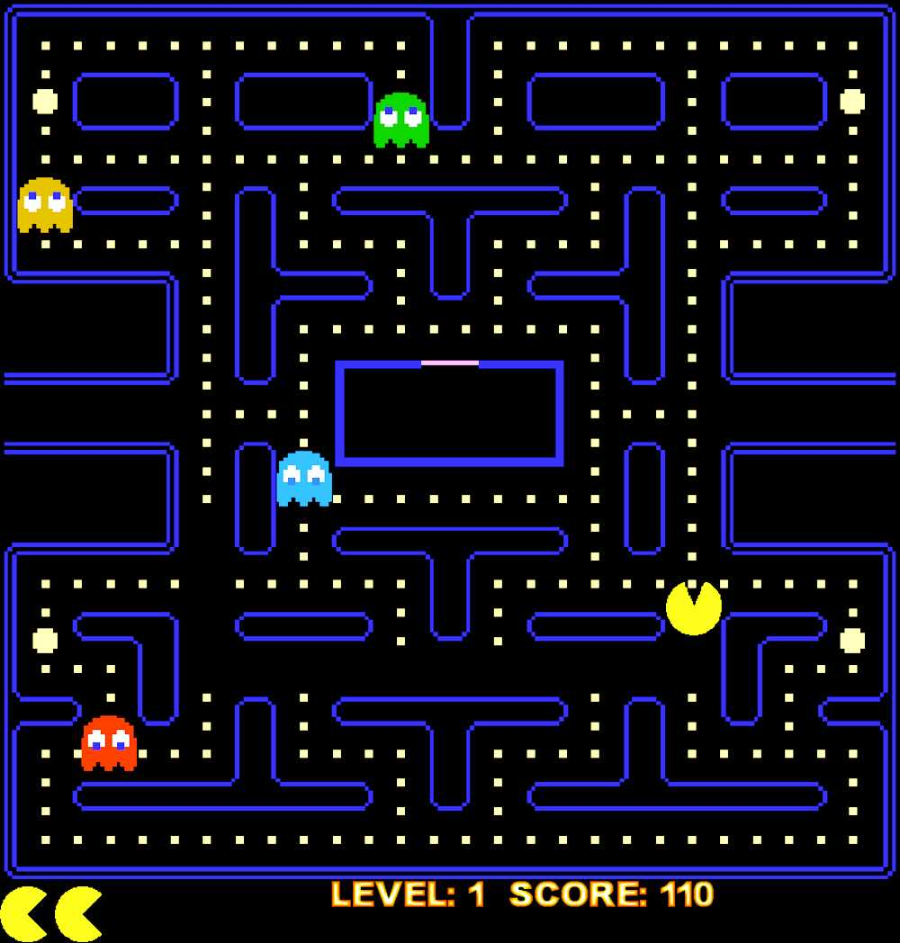
THANK YOU

